Slide 1
EEE 1211 Basic Electrical Techn Bangladesh Army University of Engineering & Technology (BAUET) EEE 1161 Electrical Circuit Analysis
Bangladesh Army University of Engineering & Technology (BAUET)
Department of Computer Science & Engineering (CSE)
Ashik Alam
Assistant Professor
Dept. of EEE, BAUET
Email: ashik.alam.eee@bauet.ac.bd

Slide 2
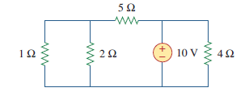
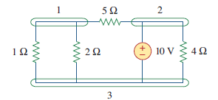
Nodes, Branches, and Loops
A branch represents a single element such as a voltage source or a resistor.
A node is the point of connection between two or more branches.
A loop is any closed path in a circuit.
A mesh is a loop which does not contain any other loops within it.
Example-1: How many branches and nodes does the following circuit have?
Here, the number of branches: 05
The number of nodes: 03
The number of meshes: 03

Slide 3

Task- 1: Determine the number of branches, nodes, loop and mesh in the circuit shown in following figure

Slide 4
Nodal analysis
Nodal analysis provides a general procedure for analyzing circuits using node voltages as the circuit variables. Choosing node voltages instead of element voltages as circuit variables is convenient and reduces the number of equations one must solve simultaneously.
Steps to Determine Node Voltages:
1. Select a node as the reference node. Assign voltages to the remaining nodes. The voltages are referenced with respect to the reference node.
2. Apply KCL to each of the nonreference nodes. Use Ohm’s law to express the branch currents in terms of node voltages.
3. Solve the resulting simultaneous equations to obtain the unknown node voltages.

Slide 5
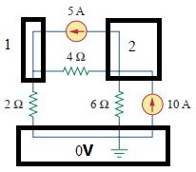
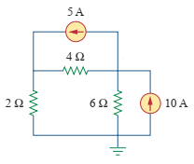
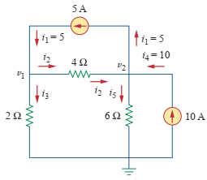
Calculate the node voltages in the circuit shown in the following figure

Slide 6


Node 1: $I_{1}=I_{2}+I_{3}$
Node 2: $I_{2}+I_{4}=I_{1}$+ $I_{5}$

Slide 7

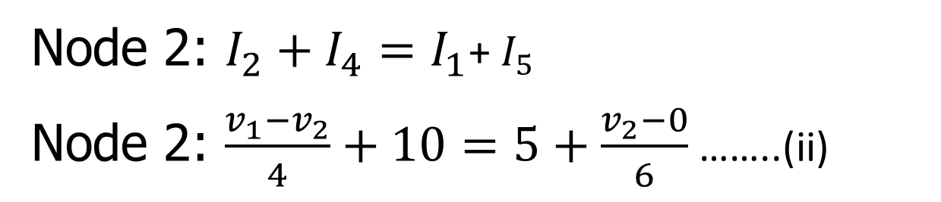
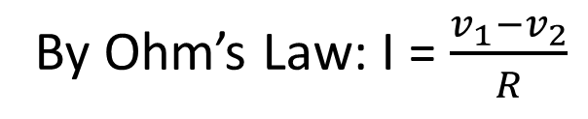
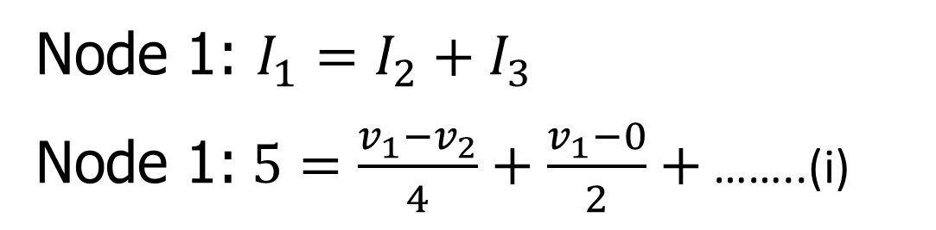
Node 1: $I_{1}=I_{2}+I_{3}$
Node 1:$5=\frac{v_{1}−v_{2}}{4}+\frac{v_{1}−0}{2}+$ ……..(i)
By Ohm’s Law: I = $\frac{v_{1}−v_{2}}{R}$
Node 2: $I_{2}+I_{4}=I_{1}$+ $I_{5}$
Node 2: $\frac{v_{1}−v_{2}}{4}+10=5+\frac{v_{2}−0}{6}$ ……..(ii)

Slide 8
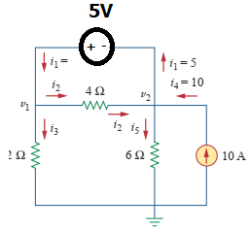
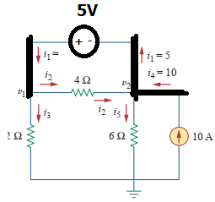

Slide 9
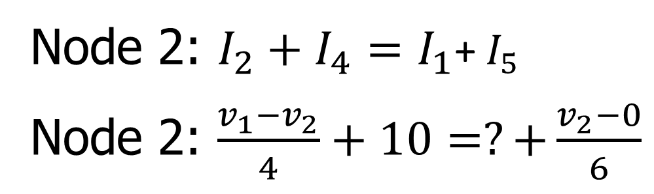
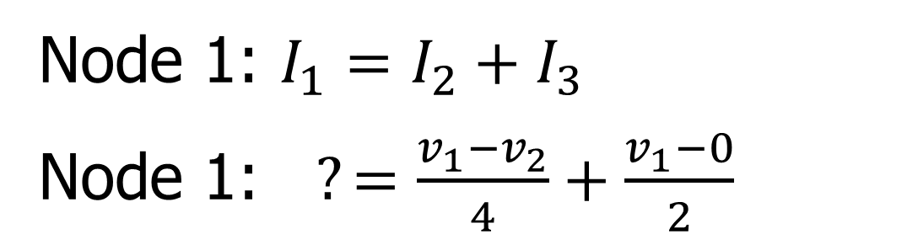
Node 1: $I_{1}=I_{2}+I_{3}$
Node 1:$?=\frac{v_{1}−v_{2}}{4}+\frac{v_{1}−0}{2}$
Node 2: $I_{2}+I_{4}=I_{1}$+ $I_{5}$
Node 2: $\frac{v_{1}−v_{2}}{4}+10=?+\frac{v_{2}−0}{6}$

Slide 10
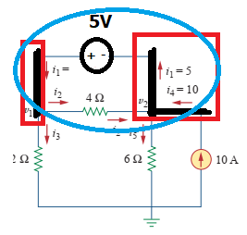

Slide 11
Thank You

